Slide 1
Neural Style Transfer
Shivang Modi AIE007 | Rudra Sarkar AIE009

Slide 2
Overview
What is Style Transfer ?
A brief history
Style Transfer using Neural Networks
Modelling Style Transfer as an optimisation problem

Slide 3
Style Transfer
CONTENT
Style

Slide 4
Style Transfer
CONTENT
CONTENT
Style

Slide 5
Style Transfer
PROGRAM
CONTENT
CONTENT
Style

Slide 6
BRIEF HISTORY OF STYLE TRANSFER
Non Photo-realistic rendering ( NPR)
Artistic rendering without CNNs
Image Based Artistic Rendering - IB-AR
Stroke Based Rendering SBR
Start from a source photo and incrementally compositing with strokes to match the photo
SBR can only depict a prescribed style. Effective in simulating certain types of styles. Eg- water color, oil painting
Region Based Techniques
Exploit the shape of the regions to guide stroke placement
Different stroke patterns can be produced in different semantic regions in an image
Same problem persists as in SBR : One region based technique is not capable of simulating an arbitrary style

Slide 7
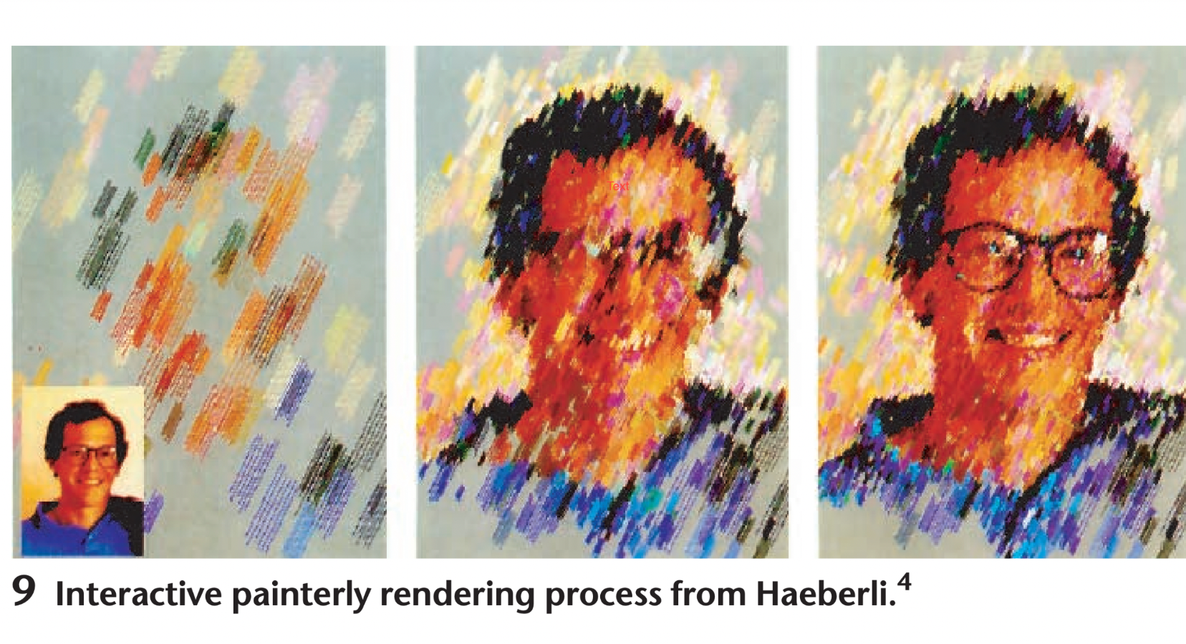
BRIEF HISTORY OF STYLE TRANSFER

Slide 8
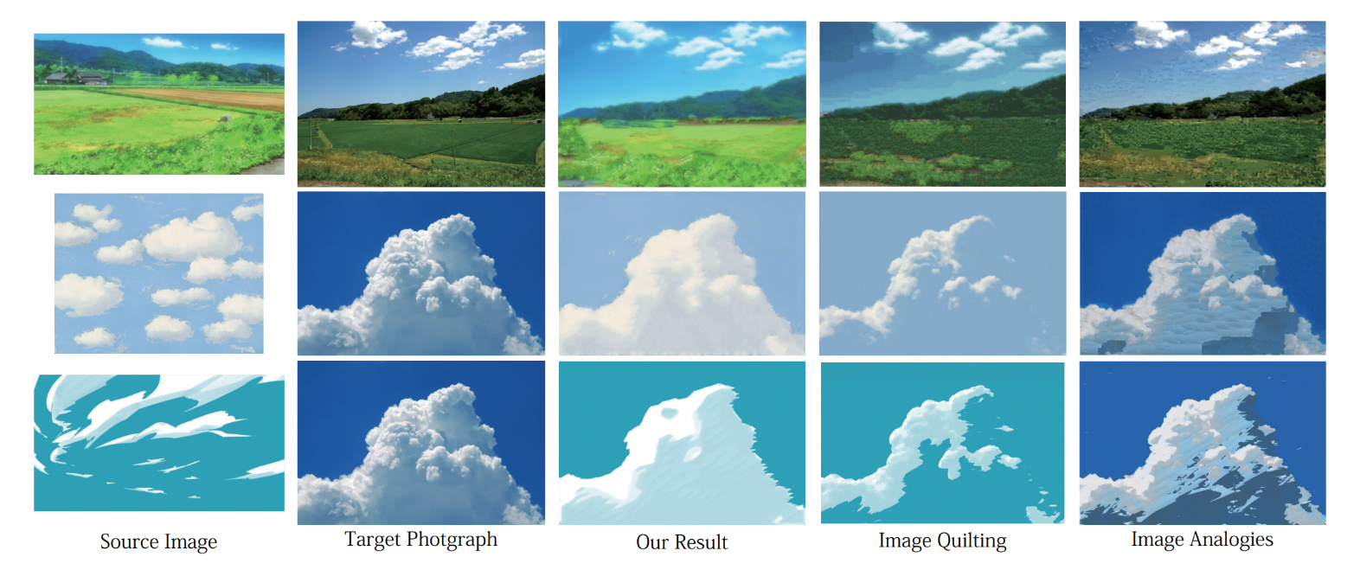
BRIEF HISTORY OF STYLE TRANSFER

Slide 9
BRIEF HISTORY OF STYLE TRANSFER
Example Based Rendering
Mapping between an exemplar pair
Learn a mapping between pair of source images and target stylised images in a supervised manner
Training set : {unstylised source images, stylised images with a particular style}
Limitations :
Pairs of training data are usually unavailable in practice
Only exploit low-level image features. Fail to effectively capture content and style

Slide 10
BRIEF HISTORY OF STYLE TRANSFER
Image Processing and Filtering
Image simplification and abstraction
Combining related image processing filters to render a given photo
Winnemöller for the first time exploited bilateral and difference of gaussian filters to automatically produce cartoon like effects

Slide 11
Style Transfer using Neural Networks

Slide 12
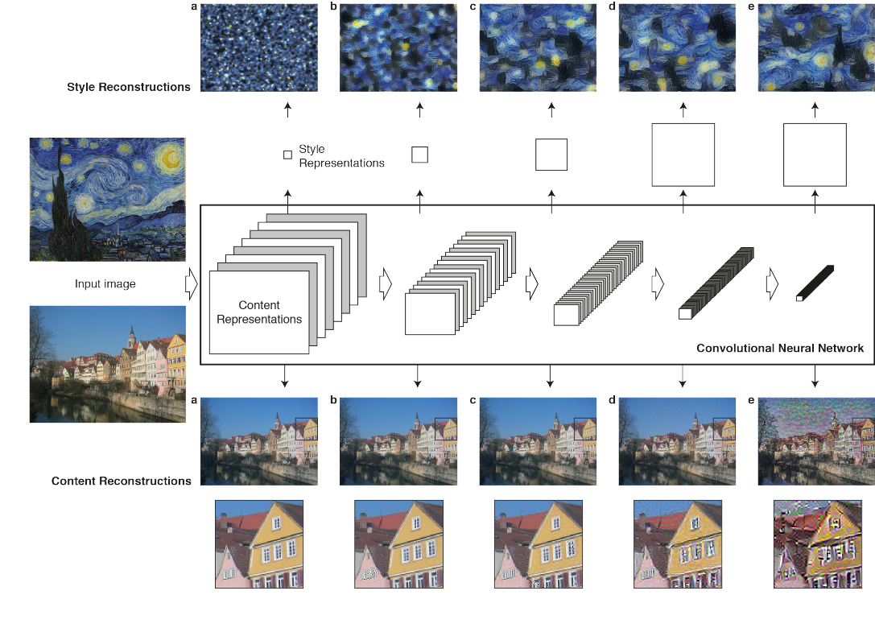
Attention areas

Slide 13
Content representations ?
Cost function and optimisation ?
Why style transfer ?
Questions
Style representations ?
Why CNN ?

Slide 14
Why CNN ?

Slide 15
Why CNN ?
We need the features

Slide 16
Why CNN ?
We need the features

Slide 17
What Features?
How do we know this is what we want for features and this is what we want for styles ?

Slide 18
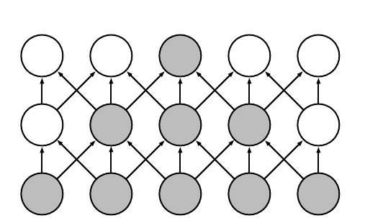
What Features?
We will start with content representation
12345
123
234
345
1
2
3
4
5

Slide 19
What Features?
We will start with content representation
So the last layer is the aggregation of all the feature maps, the CNN has discovered so far
12345
123
234
345
So, content ≡ Last layer of CNN
1
2
3
4
5

Slide 20
What Features?
But Style is more abstract
We don’t want the exact style image, we just require the essence
12345
And the essence is distributed throughout the feature maps
234
345
123
1
2
3
4
5

Slide 21
What Features?
Styles
Styles
Styles

Slide 22
What Features?
Color correlation
Brush smoothness
Brush Strokes

Slide 23
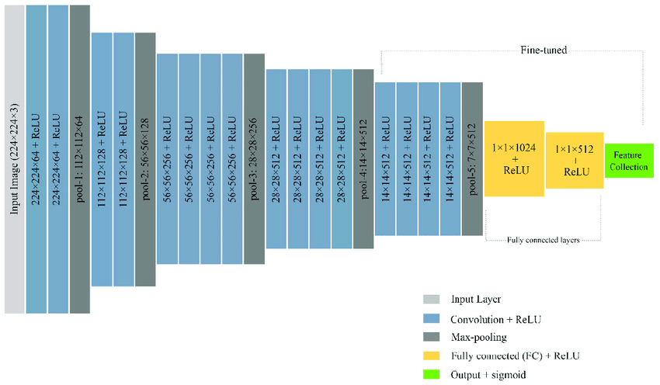
What Features?
Styles
Content

Slide 24
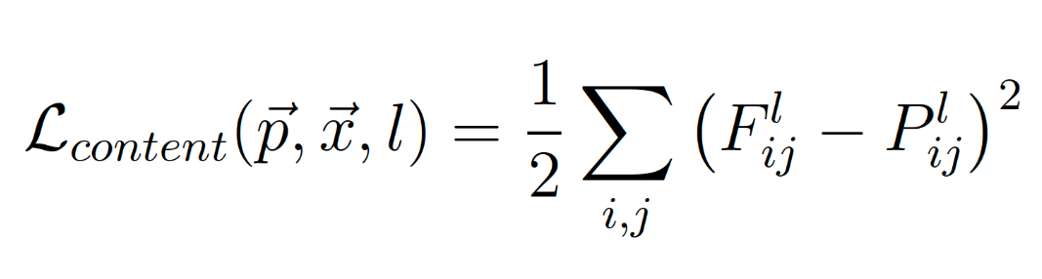
Defining it all
Layer number
CONTENT
CONTENT
Original image
Original Image
FMap
original
generated
Generated image
Generated image FMap
i, j th entry of the FMap

Slide 25
Defining it all
Style
CONTENT
But how do we measure Style Loss ?
Style is so Abstract !
So, we will use a
Gram Matrix
original
generated

Slide 26
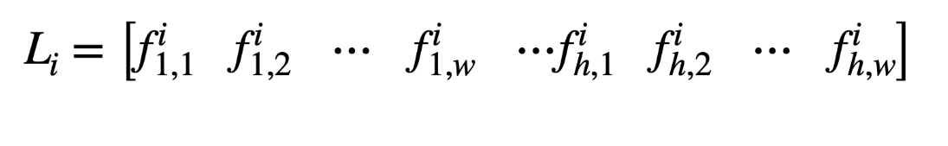
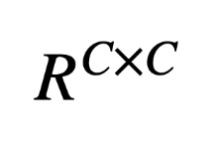
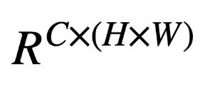
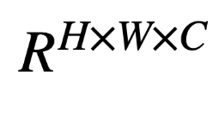
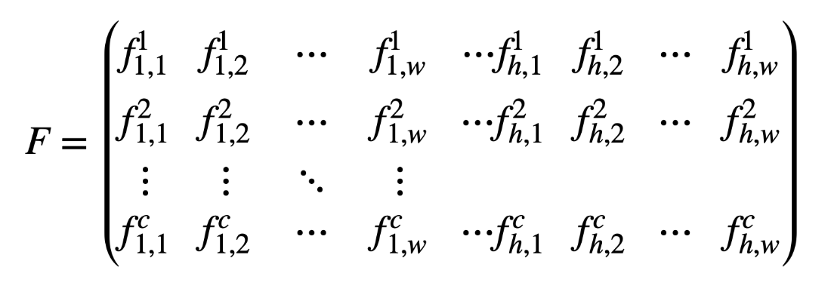
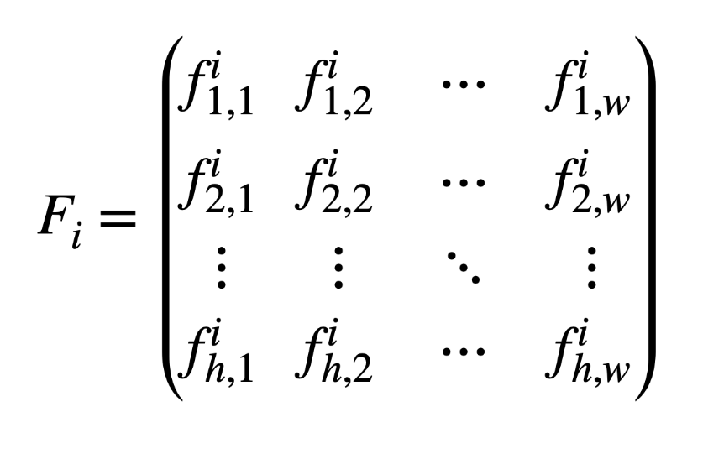
Defining it all
C
C
C
H
C
H * W
w

Slide 27

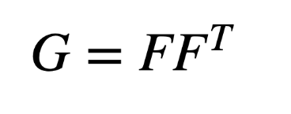
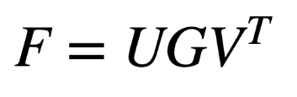
Defining it all
C
C
C
H
C
H * W
w
Gram Matrix
Intuitively we can actually think about this Gram matrix as the covariance matrix

Slide 28
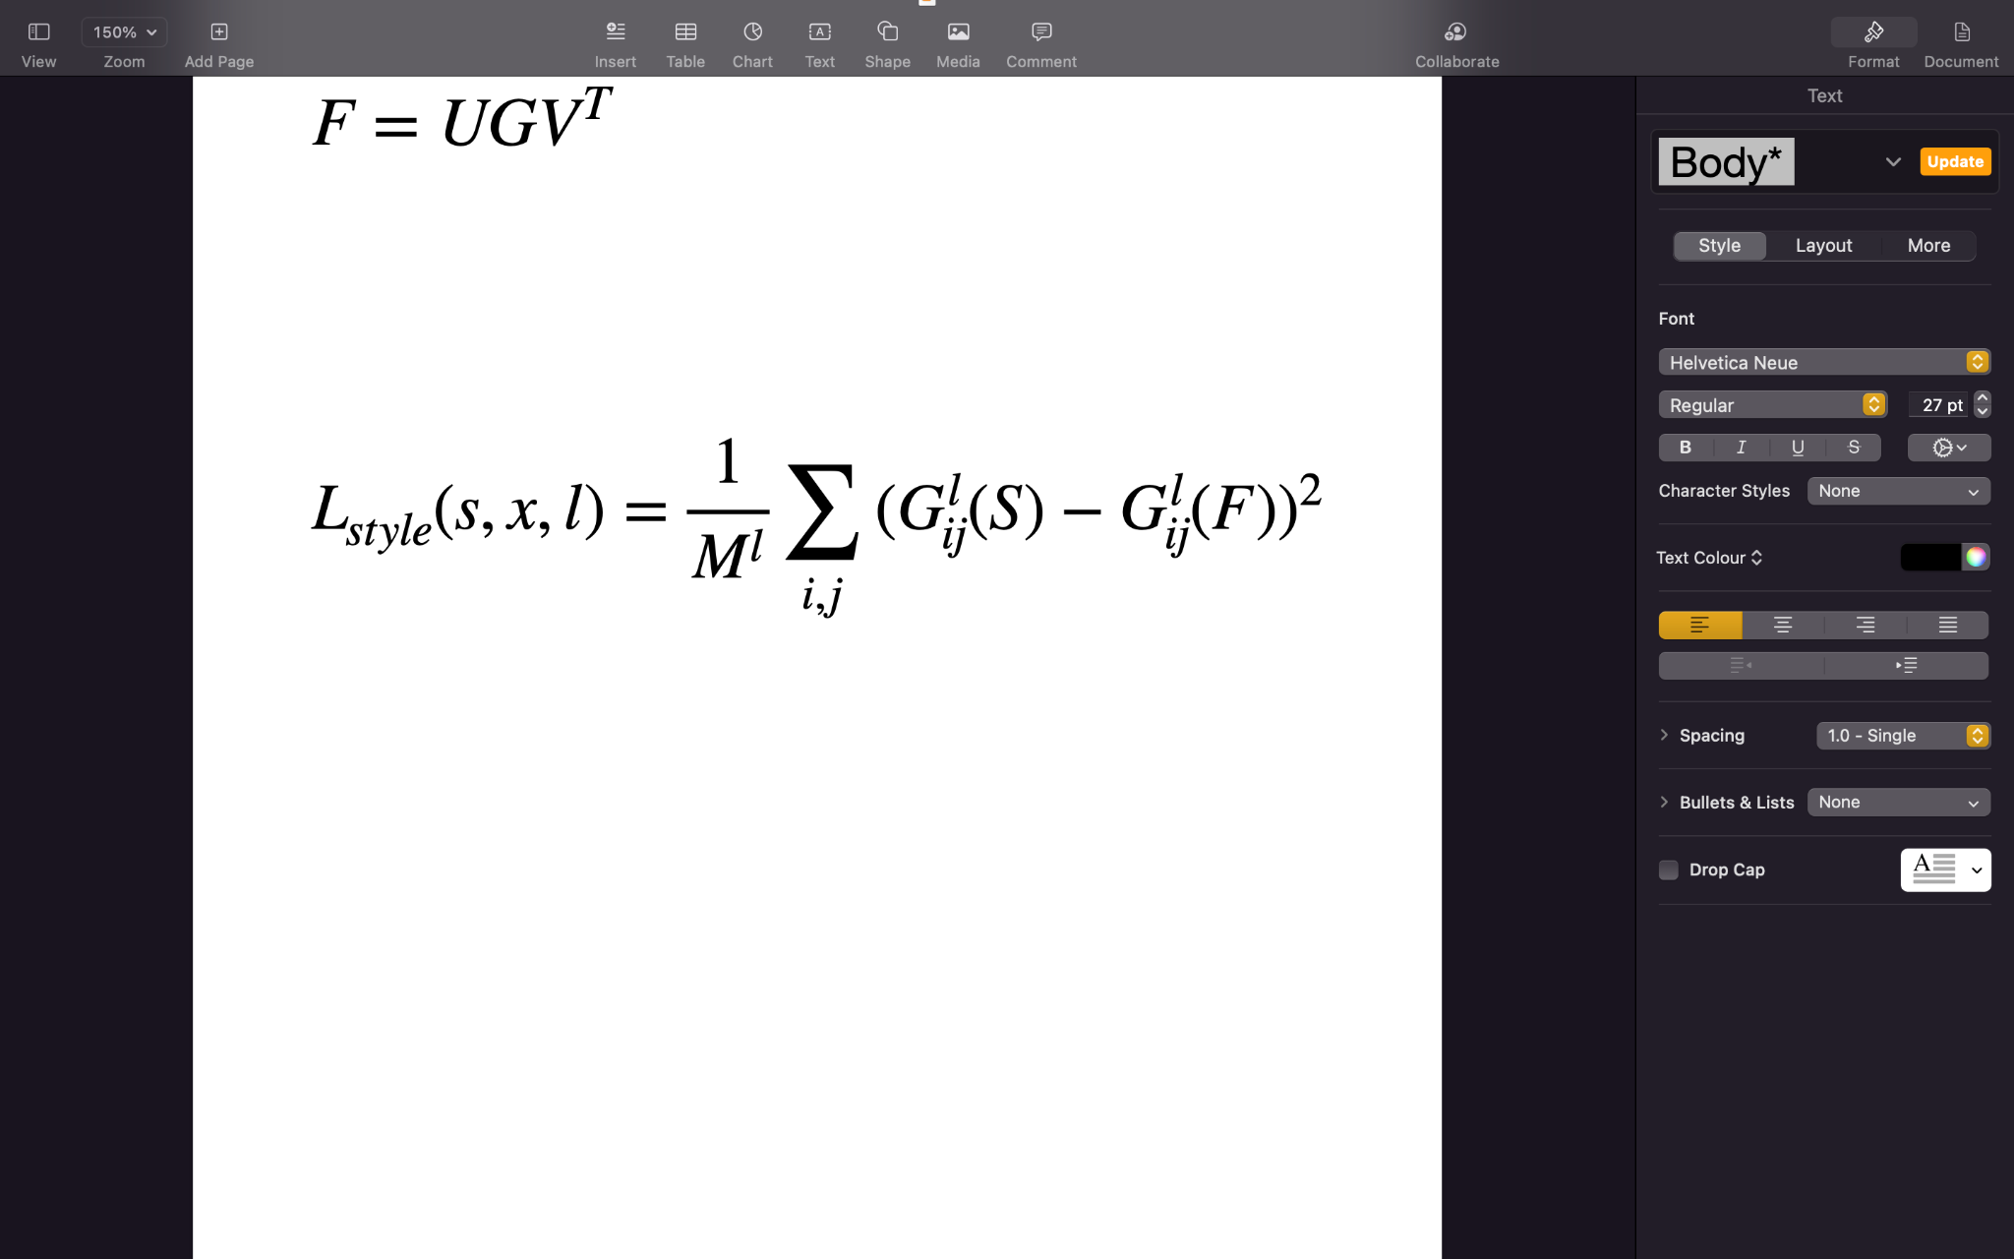
Defining it all
M = H*W
Style
CONTENT
original
generated
Generated image Gram Matrix
Style Gram Matrix

Slide 29
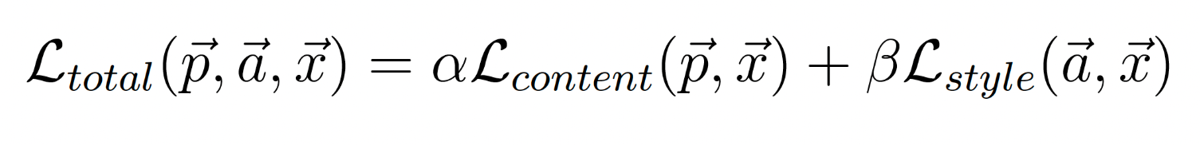
Defining it all : Total Loss Function
Specifying the weights of content and style in our final image

Slide 30
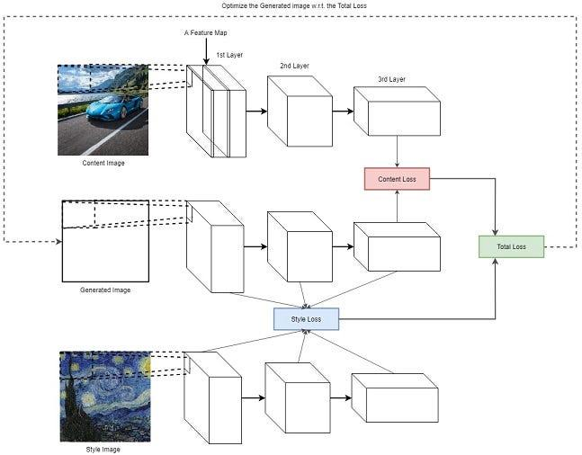
Defining it all

Slide 31
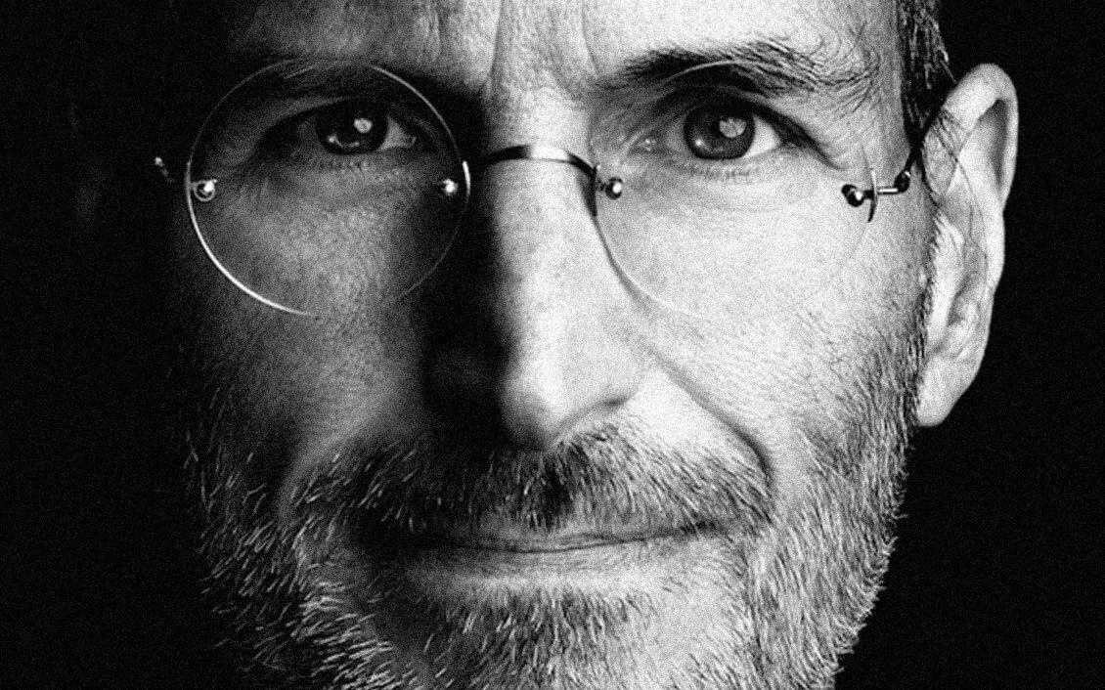
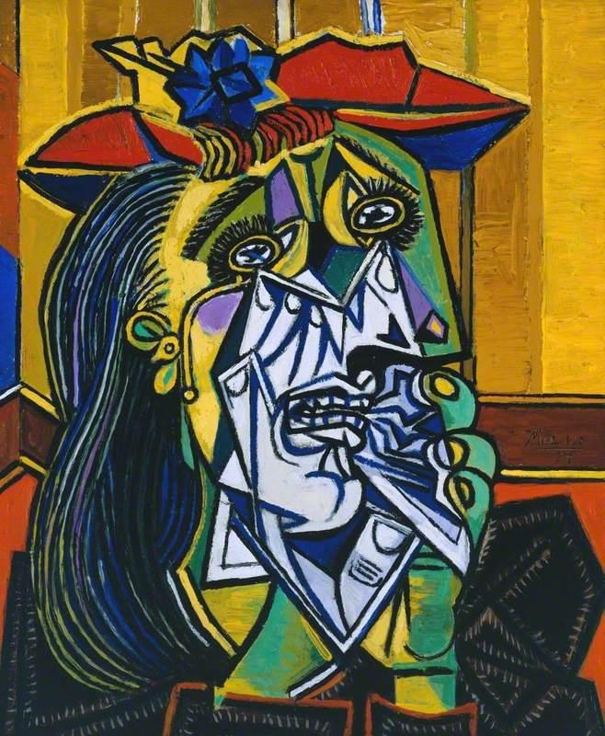
Let’s have a look
Steve Jobs
The weeping women - Pablo Picasso

Slide 32
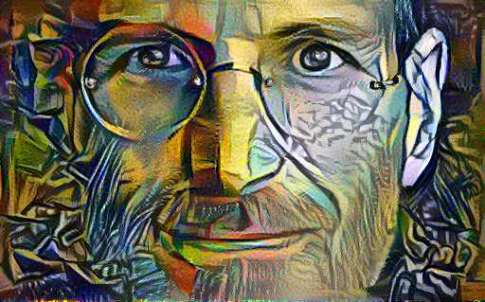
Let’s have a look
Steve Jobs
Steve Jobs : Post Style Transfer

Slide 33
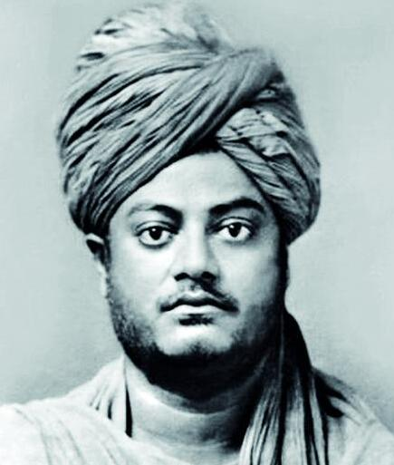
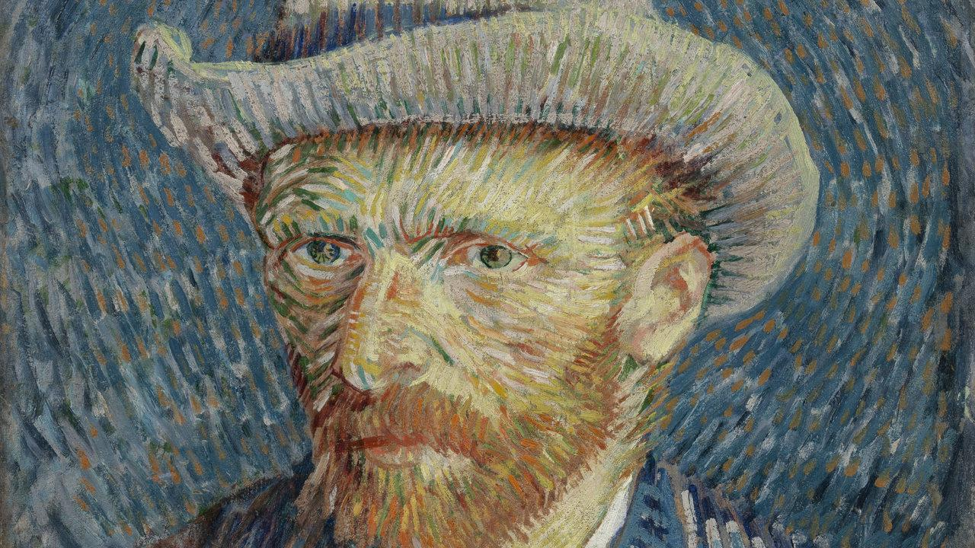
Defining it all
Van Gogh by Van Gogh
Swami Vivekananda

Slide 34
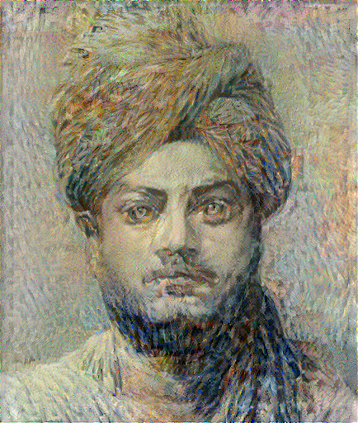
Defining it all
Swami Vivekananda
Swami Vivekananda: Post NST

Slide 35
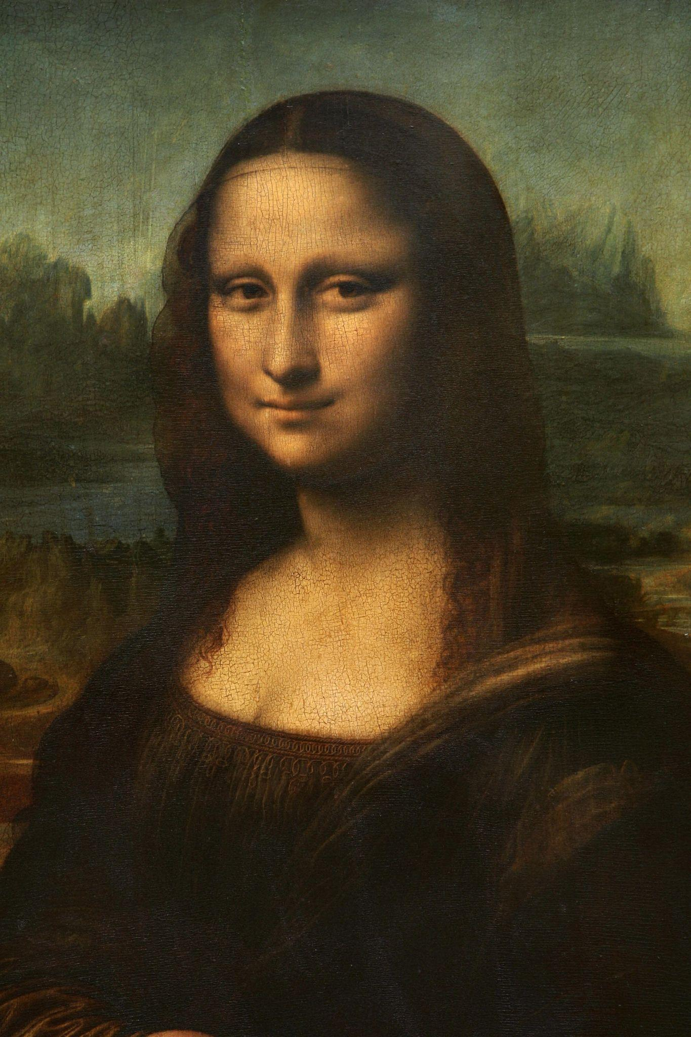
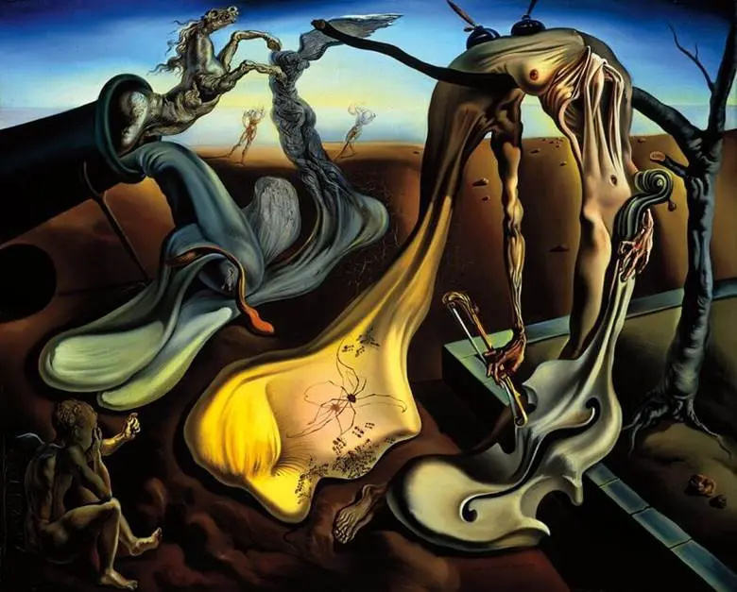
Defining it all
Mona Lisa - Vinci
Spider of the Evening : S Dali

Slide 36
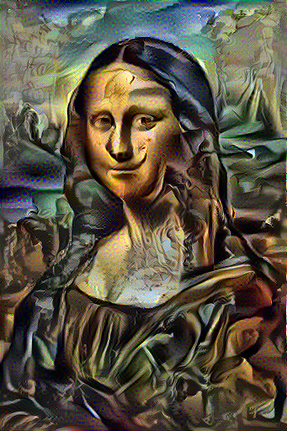
Defining it all
Mona Lisa - Vinci
Mona Lisa: Post NST

Slide 37
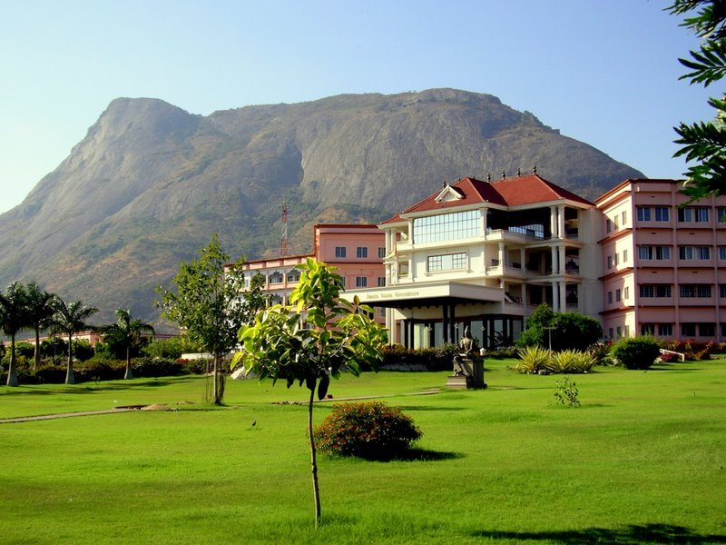
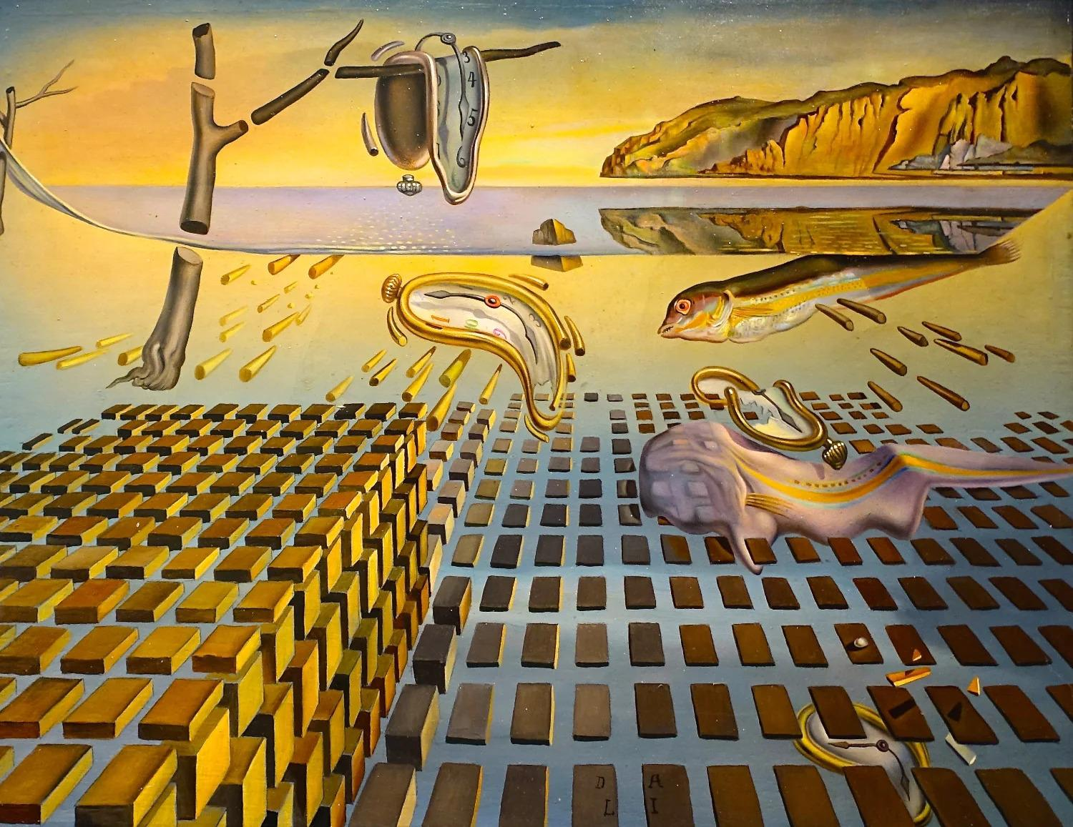
Defining it all
Amrita Vishwa Vidyapeetham
Disintegration of memory : S Dali

Slide 38
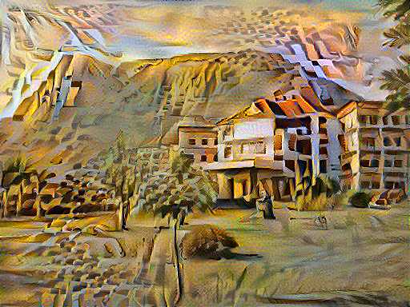
Defining it all
Amrita Vishwa Vidyapeetham
Amrita Vishwa Vidyapeetham : Post NST

Slide 39
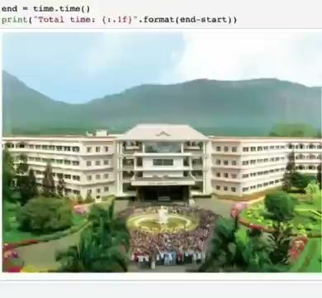
Defining it all

Slide 40
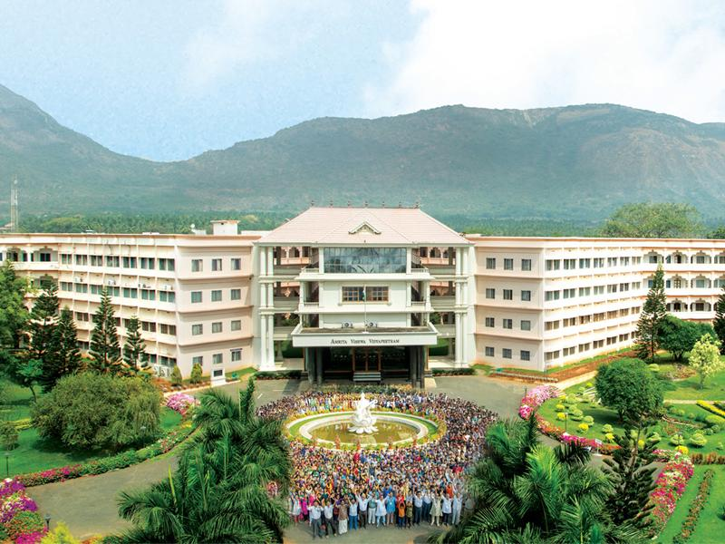
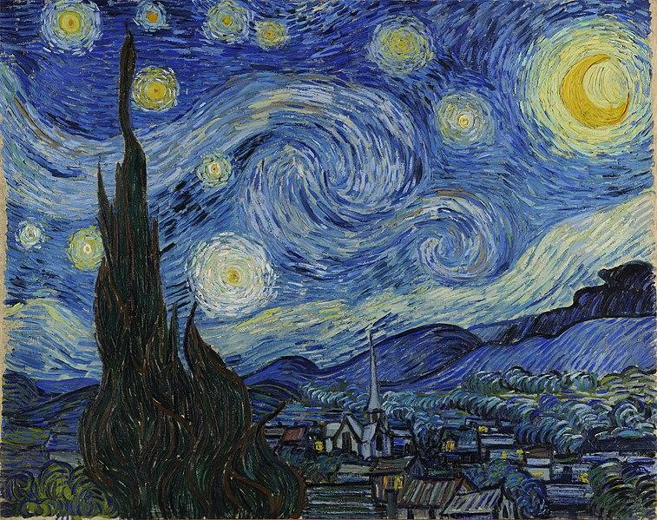
Defining it all
Amrita Vishwa Vidyapeetham
Starry Night : Van Gogh

Slide 41
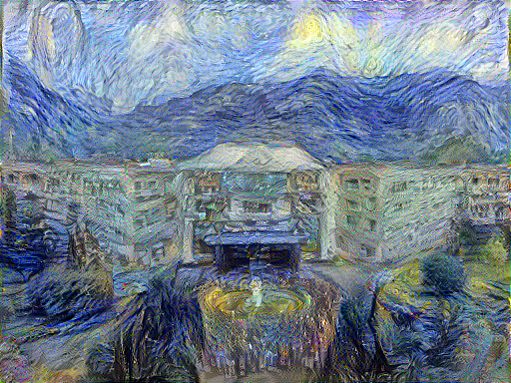
Defining it all
Amrita Vishwa Vidyapeetham
Post NST

Slide 42
References
Neural Style Transfer : A review by Yongcheng Jing, Yezhou Yang, Zunlei Feng, Jingwen Ye, Yizhou Yu, Mingli Song
A Neural Algorithm of Artistic Style by Leon A. Gatys, Alexander S. Ecker, Matthias Bethge
Towards Data Science , Medium Blogs
Tensorflow Developer Community

Slide 43
Thank You
Sayonara
Noun | Goodbye

